Slide 1
IUMI Update 2018 - Disruptive Forces in Marine Insurance
The 22nd Biennial Board of Marine Underwriters Seminar
San Francisco, May 3, 2018
Dieter Berg
Munich Re
IUMI President

Slide 2
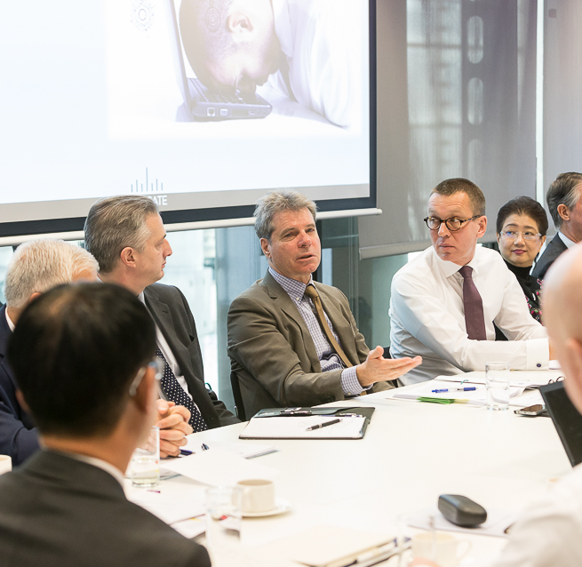
International Union of Marine Insurance
PRESIDENT OF IUMI
Dieter Berg
Senior Executive Manager
Global Marine Partnership
Munich Re, Munich
Notes:
IUMI MEMBER INDIA: Mr. Sanjiv Singh Cargo Committee New India Assurance Co. Ltd Mumbai, India

Slide 3
International Union of Marine Insurance
PRESIDENT OF IUMI
Dieter Berg
Senior Executive Manager
Global Marine Partnership
Munich Re, Munich
Notes:
IUMI MEMBER INDIA: Mr. Sanjiv Singh Cargo Committee New India Assurance Co. Ltd Mumbai, India

Slide 4
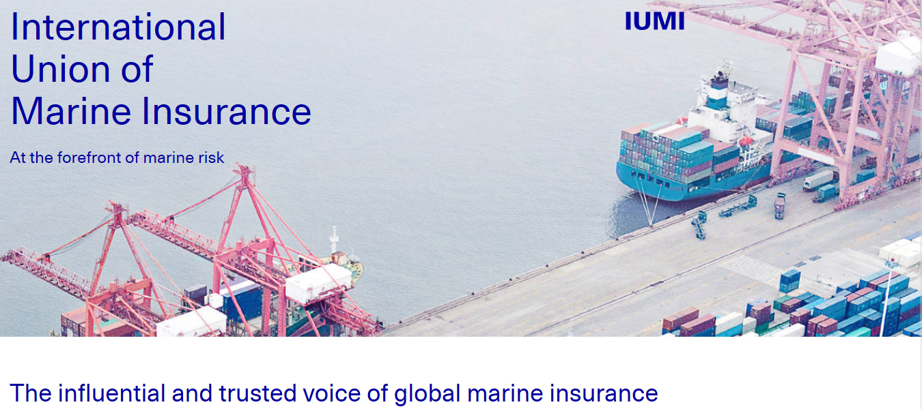
International Union of Marine Insurance
Notes:
IUMI MEMBER INDIA: Mr. Sanjiv Singh Cargo Committee New India Assurance Co. Ltd Mumbai, India

Slide 5
AIMU AT IUMI
Executive Committee | Frank Costa, Berkley Offshore, New York, NY
Technical Committees
Cargo | Sean M. Dalton, Munich Re America, New York, NY
 | Isabelle Therrien, Falvey Ins. Group, Oakville, Ontario
Facts & Figures | Erika Schoch, Swiss Re America, Armonk, NY
Hull | Michael J. McKenna, Navigators, New York, NY
Inland Hull / Fishing / Yachting | Michael Csorba, GAIG, New York, NY
Legal / Liability | Brian Murphy, Berkley Offshore, New York, NY
Loss Prevention | John Miklus, AIMU, New York, NY
 | Barry Tarnef, Chubb, Philadelphia, PA
Nomination | Dennis Marvin, AIG, Berkeley Heights, NJ
Education Forum | John Miklus, AIMU, New York, NY
 | Frank Costa, Berkley Offshore, New York, NY
Salvage Forum | Joseph G. Grasso, Wiggin & Dana, Philadelphia, PA

Slide 6
AGENDA
1. IUMI 2018
Top priorities
2. Disruptive forces in marine insurance
President’s view

Slide 7
IUMI – STRATEGIC TARGETS
Intensify IUMI’s presence globally
Communication strategy
Education program
1
Top Priorities 2018
2
Top Priorities 2018
3
Top Priorities 2018

Slide 8
IUMI – GROW THE GLOBAL FOOTPRINT … the last 12 months
1
Top Priorities 2018
Dublin
London
Brussels
Hamburg
Copenhagen
Oslo
Montreal
Beijing
Seoul
San Francisco
Tokyo
Dubai
Shanghai
Mumbai
Hong Kong
Kuala Lumpur
Singapore
Strengthen the close cooperation with IUMI members
and Affiliate members
Notes:
London
Dublin
Hamburg
Brussels
HK
Singapore
Tokyo
Mumbai
Montreal

Slide 9
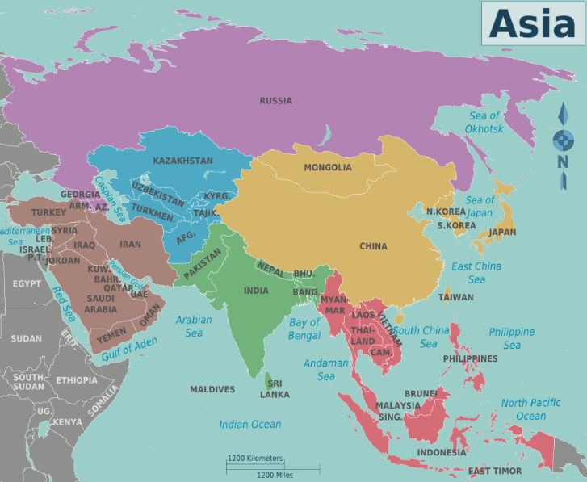
IUMI – GROW THE GLOBAL FOOTPRINT
Focus on Asia !
1
Top Priorities 2018
Last 18 months´ activities
Asia Roadshow 2016: Thailand, Malaysia, Singapore, Indonesia
ExCo market meeting Dubai
Hong Kong market meetings and conference
HK Port and Maritime Board Hamburg
ExCo market meeting and conference Mumbai
IUMI Conference Tokyo 2017
Hong Kong Maritime Week
GIA – 1st IUMI Asia Forum 2018 Singapore
Image: used under license from shutterstock.com
Image: Nick Roux / Wikimedia Commons / Image modified
IUMI officers
27 Asian Committee members, 2 ExCo members
Special envoy to Asia: Mike Davies (XL Catlin Singapore)
Special mandate of ExCo: Agnes Choi (Hong Kong)

Slide 10
IUMI – GROW THE GLOBAL FOOTPRINT Focus on Asia !
November 2016
Set-up of the first IUMI branch office: IUMI Asia hub in Hong Kong
May 2018
Launch of an annual local IUMI conference in Asia: IUMI Asia Forum
Image: pumpkinsoupsauce / Jacklee / Wikimedia Commons

Slide 11
COMMUNICATION STRATEGY
2
Top Priorities 2018
Communication to the market
IUMI is the voice of the marine insurance industry
Media work / press / public relations
Raise the public awareness of excellent work of the Technical Committees
Visibility - advocate the interests of the global marine (insurance) industry
Continuous presence in relevant forums
Addressable and responsive

Slide 12
IUMI EDUCATION
Developing an education program for the global marine insurance industry
War on talents
Strong demand from IUMI members
3
Top Priorities 2018
Achievements
Webinars
- started 6/2016: 25 webinars /
- > 3.000 participants from 56 countries
IUMI website – new database
- statistics / former conferences’ presentations / search function by keyword
Executive Certificate in Marine Insurance (Hong Kong Fed. of Ins. + HK University)
Marine Insurance Fundamentals (The Institutes, USA)
IUMI e-Learing
- IUMI Cargo Tutorial is online !
- IUMI Hull Tutorial in Q3/2018)
New training

Slide 13
The President’s View
Disruptive Forces in Marine Insurance

Slide 14
IUMI CAPE TOWN CONFERENCE 2018 Save the date

Slide 15
Thank you !
Dieter Berg
Munich Re
IUMI President

